Slide 1
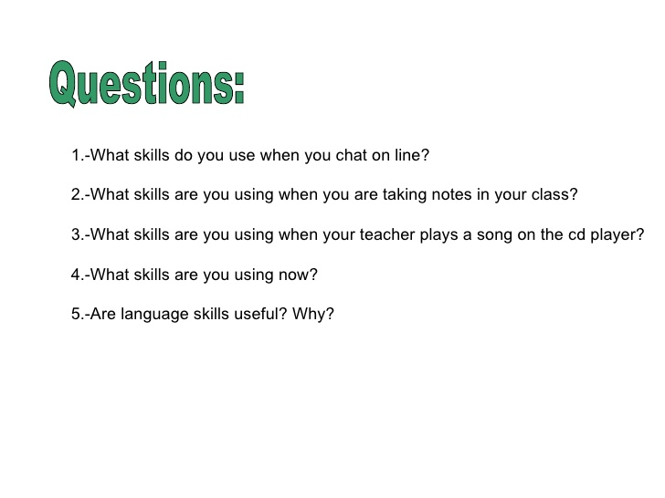
Activity

Slide 2
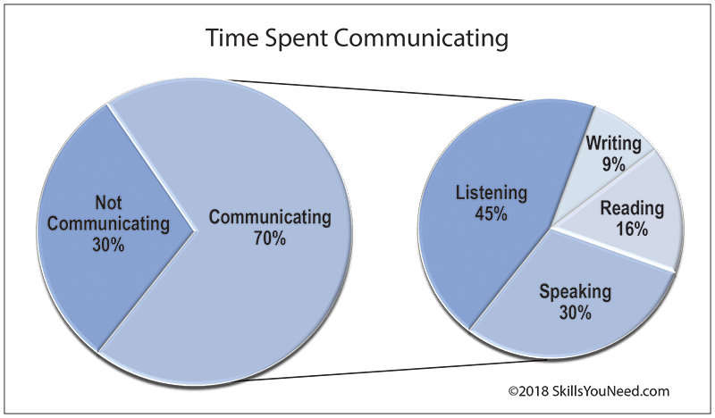
Introduction

Slide 3
Contd…,
What is LSRW?
L-S-R-W is the four skills of language learning
a set of four capabilities that allow an individual to comprehend and produce spoken language for proper and effective interpersonal communication. `
These skills are Listening, Speaking, Reading, and Writing.
In the context of first-language acquisition, the four skills are most often acquired in the order of listening first, then speaking, then possibly reading and writing.

Slide 4
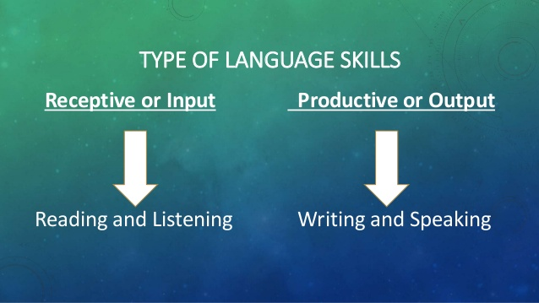

Slide 5
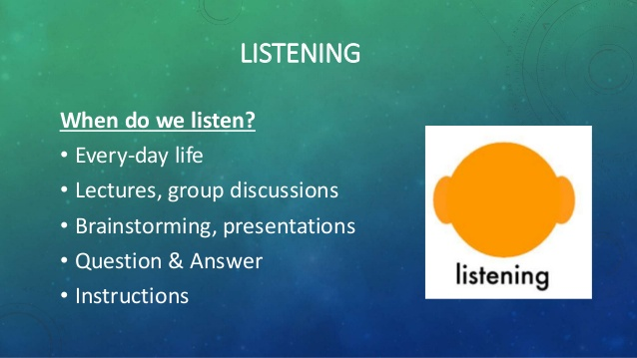

Slide 6
Contd…,

Slide 7
Contd…,

Slide 8
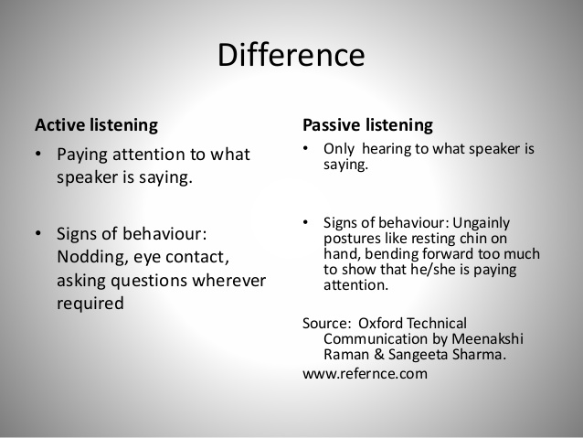
Types of Listening

Slide 9
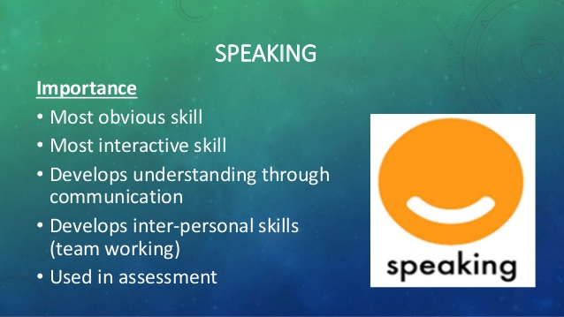

Slide 10
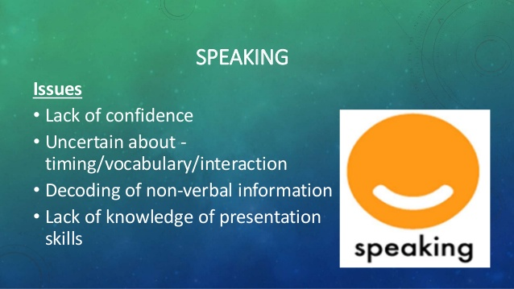
Contd…,

Slide 11
Contd…,

Slide 12
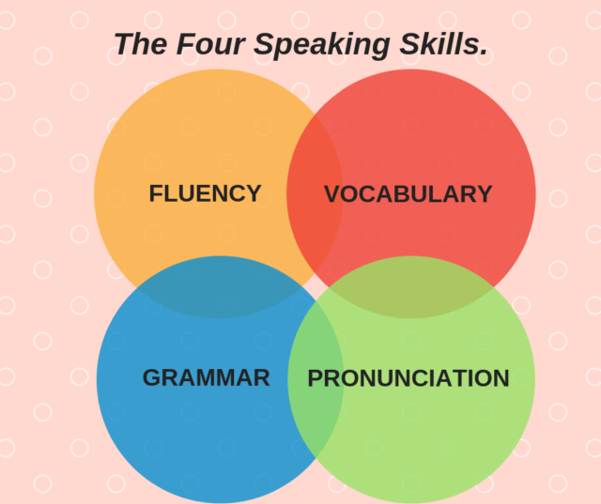
Speaking Skills

Slide 13
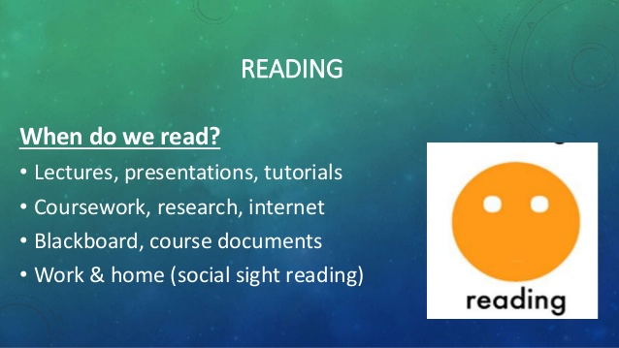

Slide 14
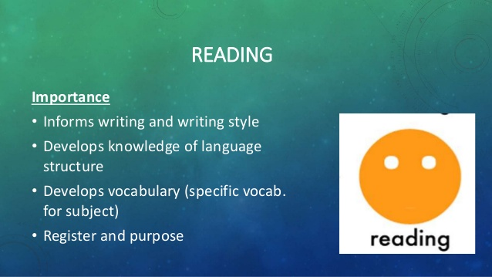
Contd…,

Slide 15
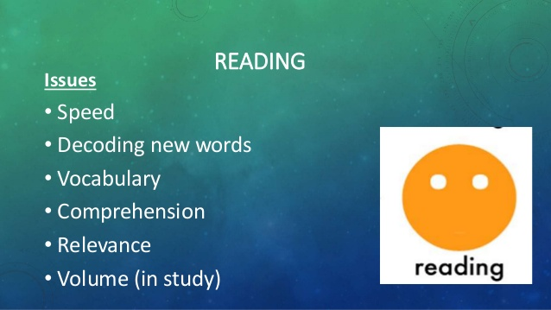
Contd…,

Slide 16
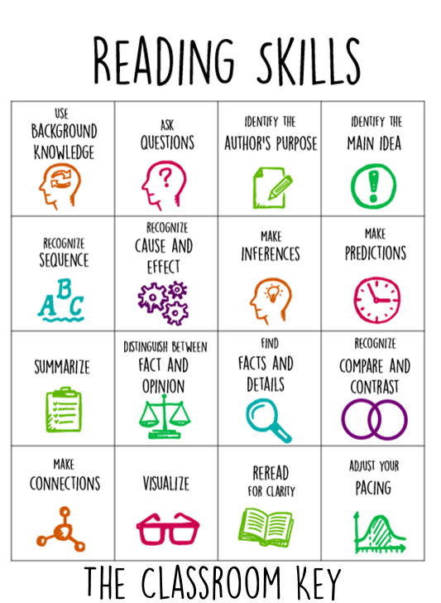

Slide 17
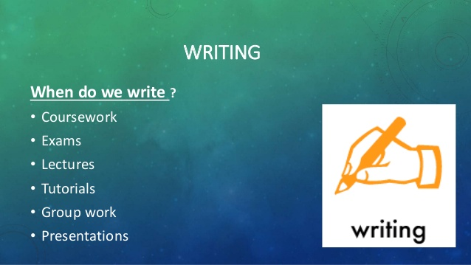

Slide 18
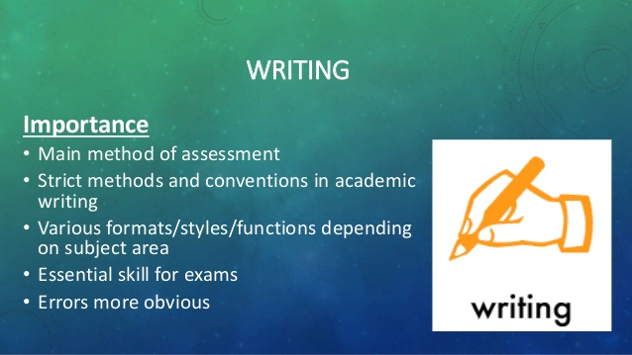
Contd…,

Slide 19
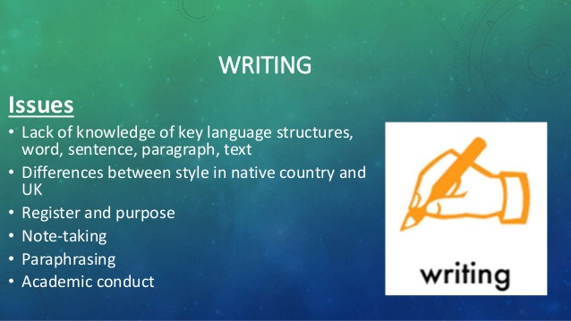
Contd…,

Slide 20


Slide 21
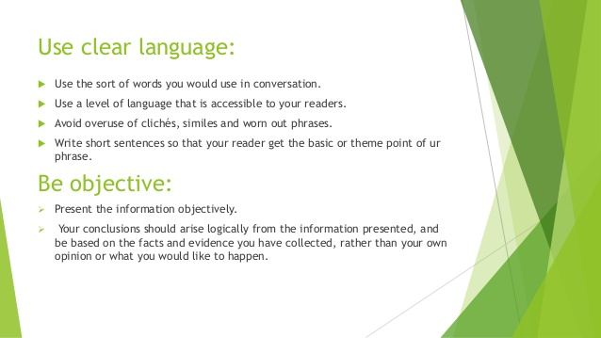
Ways to develop writing skill

Slide 22
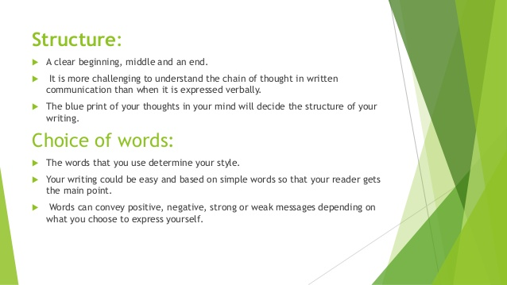
Contd…,

Slide 23
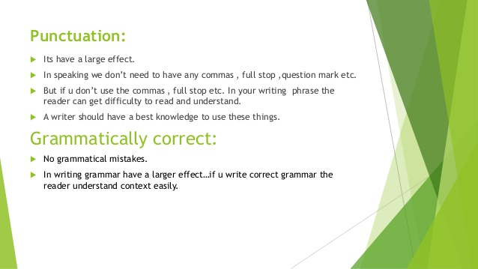
Contd…,

Slide 24
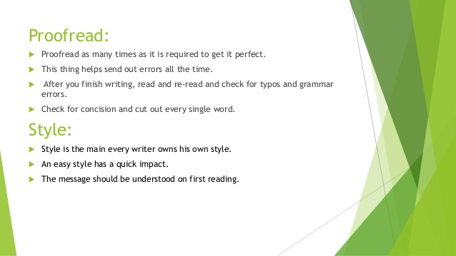
Contd…,

Slide 25
To Sum up
Success and communication are very closely related with each other.
In today's competitive world, good LSRW skills provide the right key to success.
These skills are required to maintain relationships and better understanding which are vital in both personal and professional life.
Lack of communication skills will certainly affect the future of any student.
Careers and job opportunities have made it a mandatory that employees should be proficient in the English language.
LSRW Method plays its pivotal role in the enhancement of this English speaking

Slide 26
Task

Slide 27
References
https://www.skillsyouneed.com/ips/listening-skills.html
https://www.theclassroomkey.com/2015/10/16-reading-strategies-to-teach-this-year.html
https://www.slideshare.net/arti98/active-vs-passive-listening-70858705
https://english.binus.ac.id/2018/10/11/the-four-speaking-skills/
http://languagelab.in/article-details/article/41/#:~:text=In%20today's%20competitive%20world%2C%20good,both%20

Slide 28
“Most of the successful people do more of listening than talking”
Thank You

